Slide 1


Building Smarter Solutions Using Azure and Cognitive Services
Eldert Grootenboer

Slide 2


Eldert Grootenboer
@egrootenboer

Slide 3
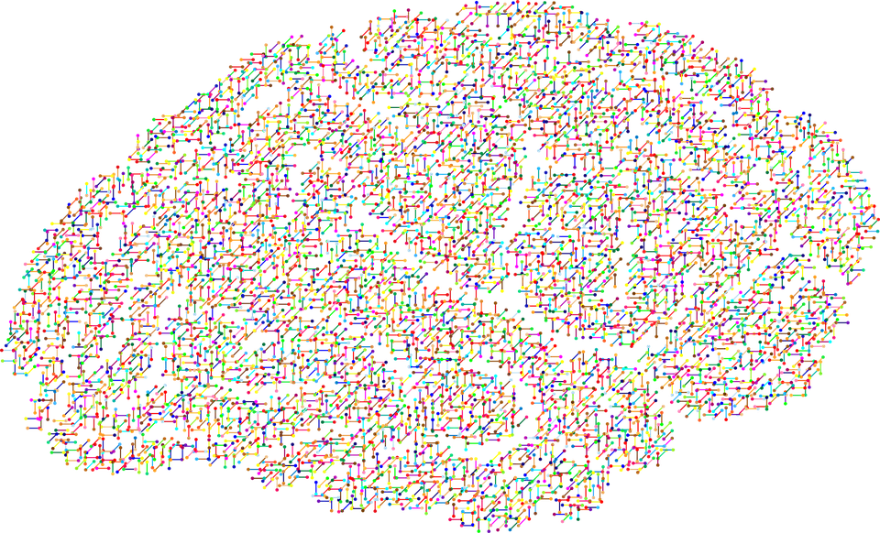
Cognitive services
Notes:
First some theory

Slide 4

Cognition
The mental action or process of acquiring knowledge and understanding through thought, experience, and the senses.

Slide 5
Cognition
The mental action or process of acquiring knowledge and understanding through thought, experience, and the senses.
Notes:
We know and understand, because we see, hear, speak, and using this input we gain better understanding of what happens around us

Slide 6
Cognitive Services
Cognitive services are a set of APIs that are designed to democratize artificial intelligence by enabling systems to see, hear, speak, understand and interpret our needs using natural methods of communication.
Notes:
Cognitive Services bring AI within reach of every developer—without requiring machine-learning expertise. All it takes is an API call to embed the ability to see, hear, speak, search, understand, and accelerate decision-making into your apps.

Slide 7
Cognitive Services
Cognitive services are a set of APIs that are designed to democratize artificial intelligence by enabling systems to see, hear, speak, understand and interpret our needs using natural methods of communication.
Notes:
SERVERLESS!
Cognitive Services bring AI within reach of every developer—without requiring machine-learning expertise. All it takes is an API call to embed the ability to see, hear, speak, search, understand, and accelerate decision-making into your apps.

Slide 8

Examples
Notes:
5

Slide 9









A variety of real-world applications
Vision
Speech
Language
Knowledge
Search
What is in the image?
Give me directions to the nearest local restaurant.
Play today’s customer call recording.
Top publications in customer lifecycle trends?
Search for ‘fraud prevention’
Computer Vision
Bing Speech
Language Understanding
Knowledge Exploration
Bing News Search
Natural Language Processing
Here are the top results:
Here is what I found:
Intent: PlayCall
Content: Customer#
DateTime.date: today
Customer Relationship Management – 5 Key Trends for 2014 CRM
Oct 28, 2015 – Here are FIVE key trends in 2014 that would help marketers in rolling ... Of late, marketers are looking at customer lifecycle management (CLM)
Information Communications Media Market News
It also investigates the top three expected Fraud Detection and Prevention programs, in terms of demand in key markets…
Predictive Customer Lifecycle Management (CLM)
The purpose of Customer Life-cycle Management (CLM) is to maximize both customer retention and .... Predictive trend analysis provides business visibility.
The Big Question: In-House or Outsourced Fraud Protection?
First, let’s point out that there is not one absolute answer—there are “pros” and “cons” to each. Those who favor in-house…
Category | People; 5 faces
Adult/Racy? | False/False
Dominant colors
Accent color
Convert spoken audio to text
Trends 2016: The Future of Customer Service
Jan 5, 2016 – The top 10 customer service trends for 2016 that .... North American Consumer
How to Protect Your Business from Online Fraud this Holiday Season
Michael heads fraud prevention tool. Online and mobile shopping are expected to continue growing apace…
Extract intent of user
Now Playing
11/29/2016 Customer Call
Language Around Customer Lifecycles in the Banking Industry
View PDF

Slide 10
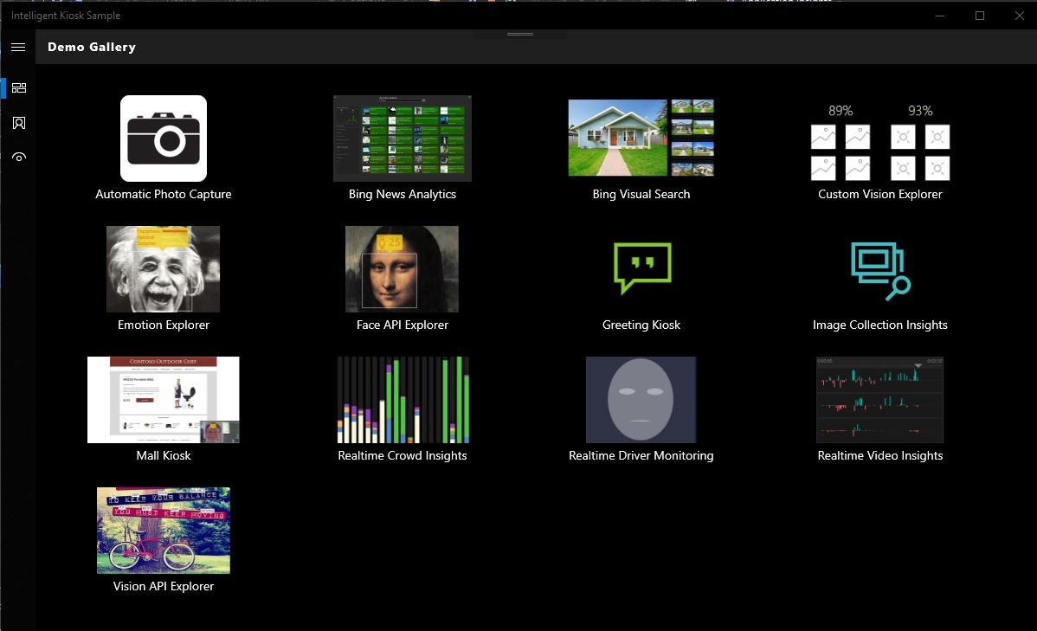
Intelligent Kiosk
http://bit.ly/intelligent-kiosk

Slide 11
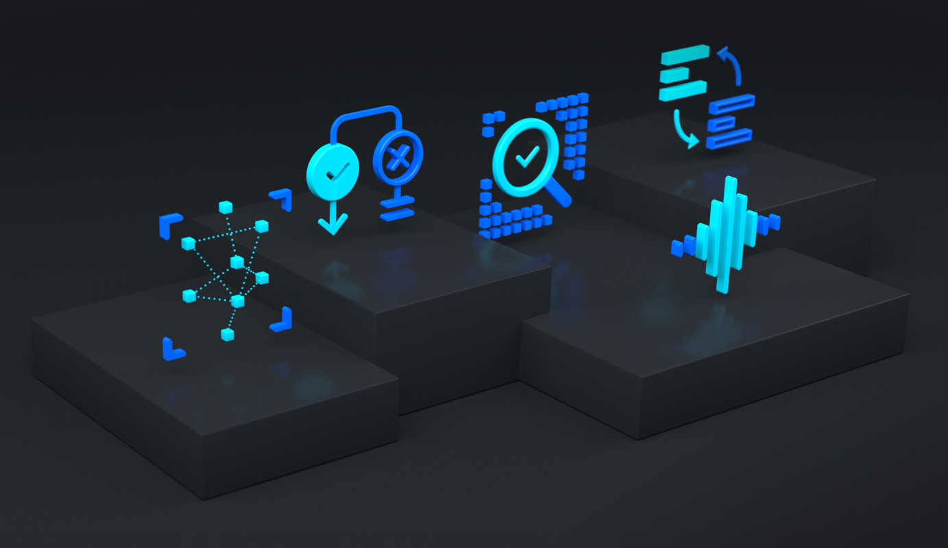
Azure Cognitive Services
Notes:
10

Slide 12
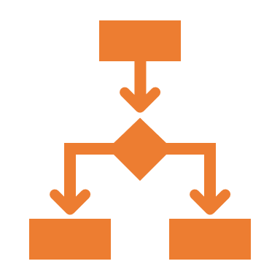




Azure Cognitive Services
Decision
Language
Speech
Vision
Web search
Notes:
Logical decision making
Natural language
Spoken language
Everything we see
Search and lookup
Cognitive Services bring AI within reach of every developer—without requiring machine-learning expertise. All it takes is an API call to embed the ability to see, hear, speak, search, understand, and accelerate decision-making into your apps.

Slide 13



Decision
Anomaly Detector
Content Moderator
Personalizer
Notes:
Let’s quickly go through each of these
Most are self explanatory
Make smarter decisions faster
Anomaly Detector ^{PREVIEW}Identify potential problems early on.
Content ModeratorDetect potentially offensive or unwanted content.
PersonalizerCreate rich, personalized experiences for every user.

Slide 14





Language
Immersive reader
Language Understanding
QnA Maker
Text Analytics
Translator
Notes:
Immersive ReaderHelp readers of all abilities comprehend text using audio and visual cues. Language UnderstandingBuild natural language understanding into apps, bots, and IoT devices.
QnA MakerCreate a conversational question and answer layer over your data.
Text AnalyticsDetect sentiment, key phrases, and named entities.
TranslatorDetect and translate more than 60 supported languages.

Slide 15



Speech
Speech to Text
Text to Speech
Speech Translation
Speaker Recognition
Notes:
Integrate speech processing into apps and services
Speech to TextTranscribe audible speech into readable, searchable text.
Text to SpeechConvert text to lifelike speech for more natural interfaces.
Speech TranslationIntegrate real-time speech translation into your apps.
Speaker Recognition ^{PREVIEW}Identify and verify the people speaking based on audio.

Slide 16





Vision
Computer Vision
Custom Vision
Face
Form Recognizer
Ink Recognizer
Video Indexer
Notes:
Identify and analyze content within images, videos, and digital ink
Computer VisionAnalyze content in images.
Custom VisionCustomize image recognition to fit your business needs.
FaceDetect and identify people and emotions in images.
Form RecognizerExtract text, key-value pairs, and tables from documents.
Ink Recognizer ^{PREVIEW}Recognize digital ink and handwriting, and pinpoint common shapes.
Video IndexerAnalyze the visual and audio channels of a video, and index its content.

Slide 17









Web search
Bing Autosuggest
Bing Custom Search
Bing Entity Search
Bing Image Search
Bing News Search
Bing Spell Check
Bing Video Search
Bing Visual Search
Bing Web Search
Notes:
Find what you’re looking for from the world-wide-web
Bing AutosuggestHelp users complete queries faster by adding intelligent type-ahead capabilities.
Bing Custom SearchCreate a custom search engine with ad-free results.
Bing Entity SearchRecognize and classify named entities, and find search results based on them.
Bing Image SearchAdd a variety of search image options to your app.
Bing News SearchTurn any app into a news search resource.
Bing Spell CheckHelp users identify and fix word breaks, slang, names, homonyms, and brands.
Bing Video SearchAdd advanced video search features to your app.
Bing Visual SearchEnable users to search using images.
Bing Web SearchEnable safe, ad-free, location-aware search for your users, surfacing relevant information from web results, images, news, videos, and visuals.

Slide 18



Why Azure Cognitive Services?
Easy
Flexible
Tested
Notes:
Serverless
Roll your own with REST APIs
Simple to add: just a few lines of code required
Integrate into the language and platform of your choice
Breadth of offerings helps you find the right API for your app
Bring your own data for your custom experience
Built by experts in their field from Microsoft Research, Bing, and Azure Machine Learning
Quality documentation, sample code, and community support

Slide 19

Bots
Notes:
17

Slide 20



Creating your bot
Power Virtual Agents
AtBot
Azure Bot Service

Slide 21
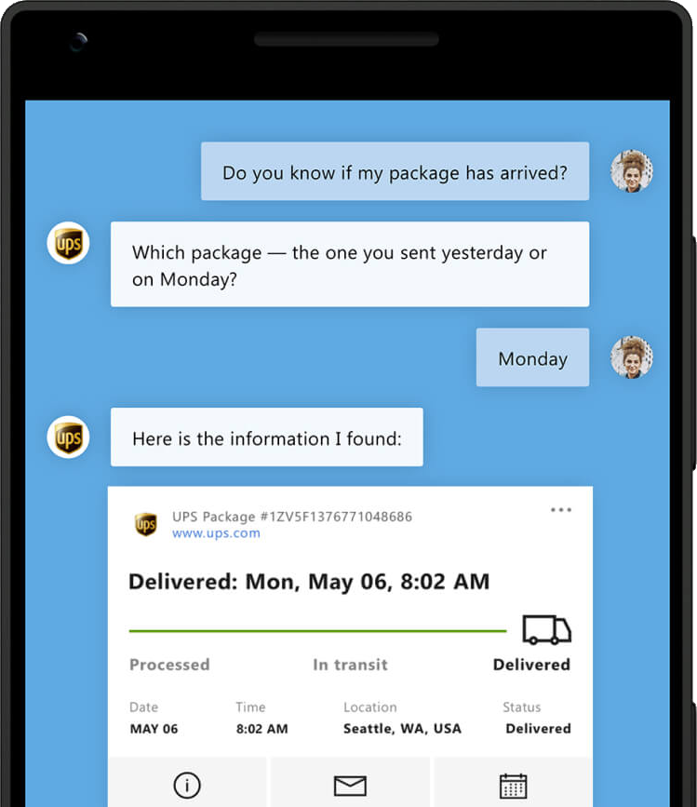
Azure Bot Service
Powerful and extendable
Integration with cognitive services
Multiple channels
Notes:
Develop intelligent, enterprise-grade bots that help you enrich the customer experience while maintaining control of your data. Build any type of bot—from a Q&A bot to your own branded virtual assistant—to quickly connect your users to the answers they need.

Slide 22

Demo time!
Notes:
20

Slide 23

Scenario

Slide 24
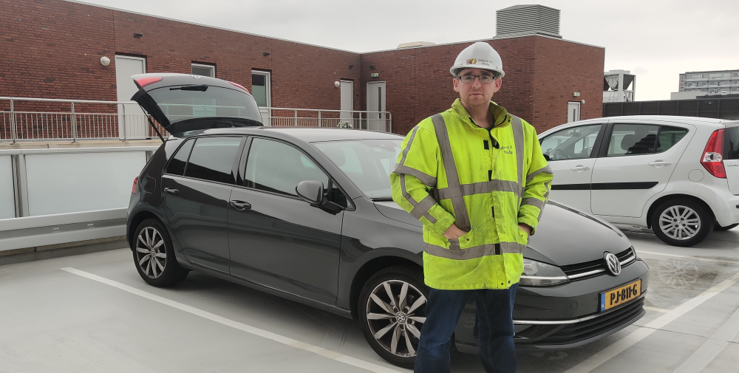
Scenario

Slide 25

Scenario

Slide 26
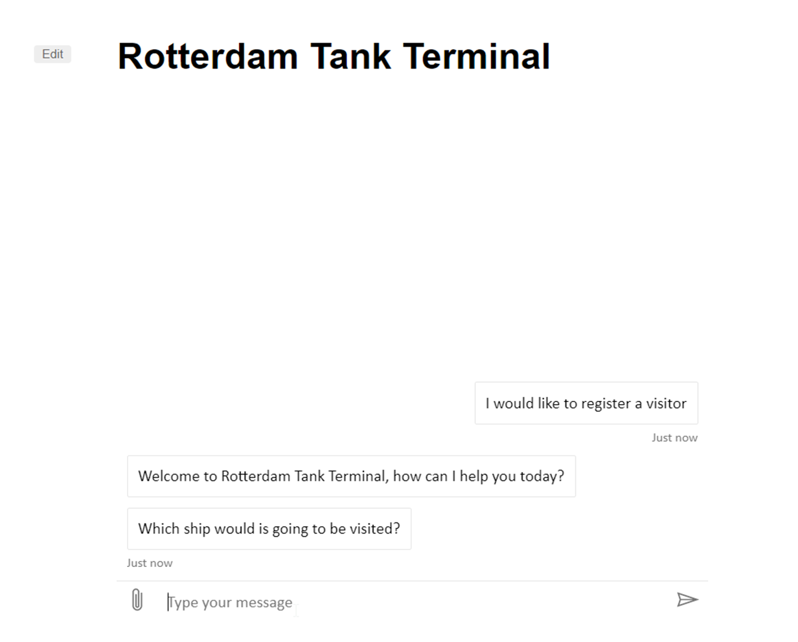


Registration
Email
Chat

Slide 27
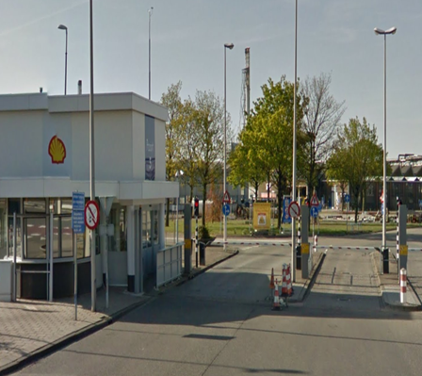


Gate arrival
Known person
Registered

Slide 28
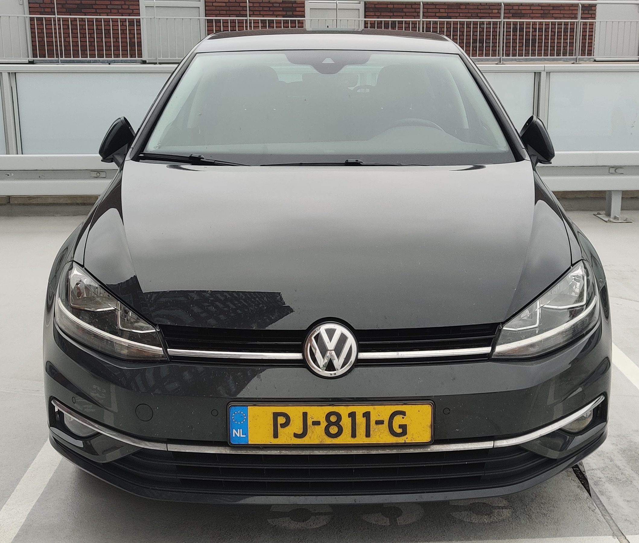


Vehicle check
Technical status
Fuel type

Slide 29
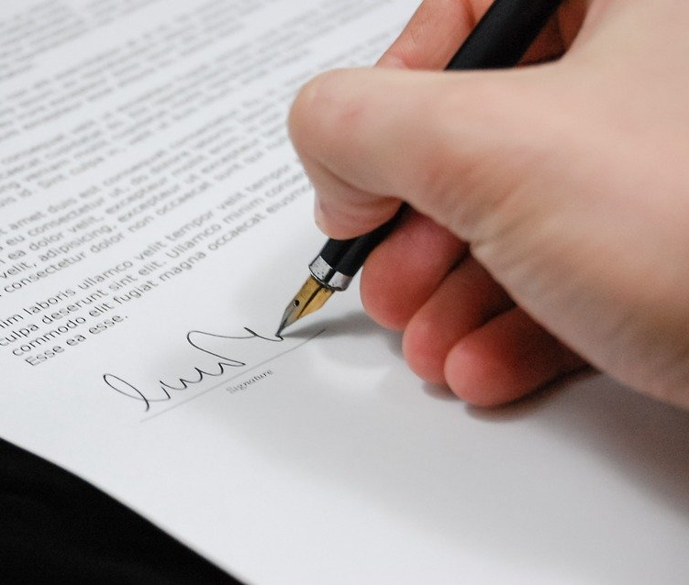


Departure
Worksheet
Check approvals

Slide 30

Almost done…

Slide 31
Take aways
Easy
Very low-entry to do complex work
Extensive
Many options and keeps expanding
Integrate
Use cognitive services in your processes

Slide 32



Thank You!
@egrootenboer
eldert@eldert.net
https://www.linkedin.com/in/eldert-grootenboer
Notes:
Rustig spreken!

Slide 33

Plane
Car
Bike

